Slide 1
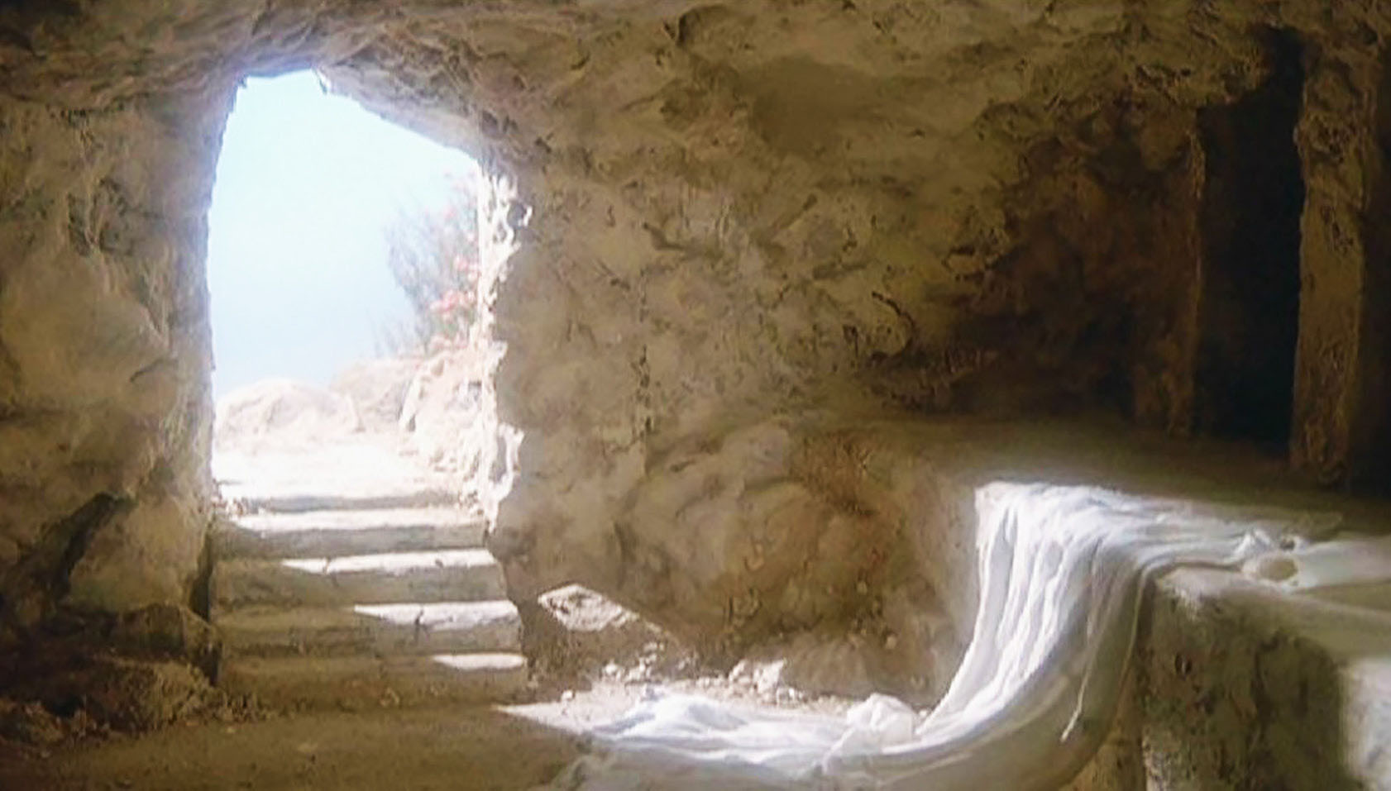
The Revelation of the Resurrected Christ
(selected texts)
April 17, 2022

Slide 2
1 Corinthians 15:16-19
16 For if the dead are not raised, not even Christ has been raised; 17 and if Christ has not been raised, your faith is worthless; you are still in your sins. 18 Then those also who have fallen asleep in Christ have perished. 19 If we have hoped in Christ in this life only, we are of all men most to be pitied.

Slide 3
1 Corinthians 15:55
“O death, where is Your victory? O death, where is Your sting?”

Slide 4
The Book of revelation
It is a book…
About the future
Of mystery
Of difficulty
Of symbolism
Of judgment
About the Resurrected Christ!
The revelation of Jesus Christ, which God gave Him to show to His bond-servants, the things which must soon take place…(Revelation 1:1)
He who testifies to these things say, "Yes, I am coming quickly." Amen. Come, Lord Jesus. The grace of the Lord Jesus be with all. Amen. (Revelation 22:20-21)

Slide 5
2 Thessalonians 2:6-10
6 And you know what restrains him now, so that in his time he will be revealed. 7 For the mystery of lawlessness is already at work; only he who now restrains will do so until he is taken out of the way. 8 Then that lawless one will be revealed whom the Lord will slay with the breath of His mouth and bring to an end by the appearance of His coming; 9 that is, the one whose coming is in accord with the activity of Satan, with all power and signs and false wonders, 10 and with all the deception of wickedness for those who perish, because they did not receive the love of the truth so as to be saved.

Slide 6
1 Peter 1:10-11
10 As to this salvation, the prophets who prophesied of the grace that would come to you made careful searches and inquiries, 11 seeking to know what person or time the Spirit of Christ within them was indicating as He predicted the sufferings of Christ and the glories to follow.

Slide 7
Revelation 19:11-16
11 And I saw heaven opened, and behold, a white horse, and He who sat on it is called Faithful and True, and in righteousness He judges and wages war. 12 His eyes are a flame of fire, and on His head are many diadems; and He has a name written on Him which no one knows except Himself. 13 He is clothed with a robe dipped in blood, and His name is called The Word of God. 14 And the armies which are in heaven, clothed in fine linen, white and clean, were following Him on white horses. 15 From His mouth comes a sharp sword, so that with it He may strike down the nations, and He will rule them with a rod of iron; and He treads the wine press of the fierce wrath of God, the Almighty. 16 And on His robe and on His thigh He has a name written, "KING OF KINGS, AND LORD OF LORDS."

Slide 8
Revelation 1:4-5
4 John to the seven churches that are in Asia: Grace to you and peace, from Him who is and who was and who is to come, and from the seven Spirits who are before His throne, 5 and from Jesus Christ, the faithful witness, the firstborn of the dead, and the ruler of the kings of the earth.
Psalm 89:27 - “I also shall make him My firstborn, the highest of the kings of the earth."

Slide 9
Colossian 1:18
He [Jesus] is also head of the body, the church; and He is the beginning, the firstborn from the dead, so that He Himself will come to have first place in everything.

Slide 10
Revelation 1:7
Behold, He is coming with the clouds, and every eye will see Him, even those who pierced Him; and all the tribes of the earth will mourn over Him. So it is to be. Amen.

Slide 11
Daniel 7:13-14
13 I kept looking in the night visions, And behold, with the clouds of heaven One like a Son of Man was coming, And He came up to the Ancient of Days And was presented before Him. 14 And to Him was given dominion, Glory and a kingdom, That all the peoples, nations and men of every language Might serve Him. His dominion is an everlasting dominion Which will not pass away; And His kingdom is one Which will not be destroyed.

Slide 12
Zechariah 12:10
I will pour out on the house of David and on the inhabitants of Jerusalem, the Spirit of grace and of supplication, so that they will look on Me whom they have pierced; and they will mourn for Him, as one mourns for an only son, and they will weep bitterly over Him like the bitter weeping over a firstborn.

Slide 13
Revelation 1:10-13a
10 was in the Spirit on the Lord's day, and I heard behind me a loud voice like the sound of a trumpet, 11 saying, "Write in a book what you see, and send it to the seven churches: to Ephesus and to Smyrna and to Pergamum and to Thyatira and to Sardis and to Philadelphia and to Laodicea." 12 Then I turned to see the voice that was speaking with me. And having turned I saw seven golden lampstands; 13 and in the middle of the lampstands I saw one like a son of man…

Slide 14
Revelation 1:13b-16
…clothed in a robe reaching to the feet, and girded across His chest with a golden sash. 14 His head and His hair were white like white wool, like snow; and His eyes were like a flame of fire. 15 His feet were like burnished bronze, when it has been made to glow in a furnace, and His voice was like the sound of many waters. 16 In His right hand He held seven stars, and out of His mouth came a sharp two-edged sword; and His face was like the sun shining in its strength.

Slide 15
Revelation 1:17-18
17 When I saw Him, I fell at His feet like a dead man. And He placed His right hand on me, saying, "Do not be afraid; I am the first and the last, 18 and the living One; and I was dead, and behold, I am alive forevermore, and I have the keys of death and of Hades.

Slide 16
Revelation 20:11-15
11 Then I saw a great white throne and Him who sat upon it, from whose presence earth and heaven fled away, and no place was found for them. 12 And I saw the dead, the great and the small, standing before the throne, and books were opened; and another book was opened, which is the book of life; and the dead were judged from the things which were written in the books, according to their deeds. 13 And the sea gave up the dead which were in it, and death and Hades gave up the dead which were in them; and they were judged, every one of them according to their deeds. 14 Then death and Hades were thrown into the lake of fire. This is the second death, the lake of fire. 15 And if anyone's name was not found written in the book of life, he was thrown into the lake of fire.

Slide 17
1 Corinthians 15:20-22
20 But now Christ has been raised from the dead, the first fruits of those who are asleep. 21 For since by a man came death, by a man also came the resurrection of the dead. 22 For as in Adam all die, so also in Christ all will be made alive.

Slide 18
Revelation 2:8-10
8 And to the angel of the church in Smyrna write: The first and the last, who was dead, and has come to life, says this: 9 I know your tribulation and your poverty (but you are rich), and the blasphemy by those who say they are Jews and are not, but are a synagogue of Satan. 10 Do not fear what you are about to suffer. Behold, the devil is about to cast some of you into prison, so that you will be tested, and you will have tribulation for ten days. Be faithful until death, and I will give you the crown of life.

Slide 19
Revelation 5:1-4
1 I saw in the right hand of Him who sat on the throne a book written inside and on the back, sealed up with seven seals. 2 And I saw a strong angel proclaiming with a loud voice, "Who is worthy to open the book and to break its seals?" 3 And no one in heaven or on the earth or under the earth was able to open the book or to look into it. 4 Then I began to weep greatly because no one was found worthy to open the book or to look into it;

Slide 20
Revelation 5:5-7
5 and one of the elders said to me, "Stop weeping; behold, the Lion that is from the tribe of Judah, the Root of David, has overcome so as to open the book and its seven seals." 6 And I saw between the throne (with the four living creatures) and the elders a Lamb standing, as if slain, having seven horns and seven eyes, which are the seven Spirits of God, sent out into all the earth. 7 And He came and took the book out of the right hand of Him who sat on the throne.

Slide 21
Revelation 5:8-10
8 When He had taken the book, the four living creatures and the twenty-four elders fell down before the Lamb, each one holding a harp and golden bowls full of incense, which are the prayers of the saints. 9 And they sang a new song, saying, “Worthy are You to take the book and to break its seals; for You were slain, and purchased for God with Your blood men from every tribe and tongue and people and nation. 10 “You have made them to be a kingdom and priests to our God; and they will reign upon the earth.”

Slide 22
Isaiah 53:10-11
10 But the LORD was pleased To crush Him, putting Him to grief; If He would render Himself as a guilt offering, He will see His offspring, He will prolong His days, And the good pleasure of the LORD will prosper in His hand. 11 As a result of the anguish of His soul, He will see it and be satisfied; By His knowledge the Righteous One, My Servant, will justify the many, As He will bear their iniquities.

Slide 23
Revelation 5:11-12
11 Then I looked, and I heard the voice of many angels around the throne and the living creatures and the elders; and the number of them was myriads of myriads, and thousands of thousands, 12 saying with a loud voice, "Worthy is the Lamb that was slain to receive power and riches and wisdom and might and honor and glory and blessing."

Slide 24
It is the Lamb who…
Breaks the seals (6:1)
Is worshipped (7:9)
In whose blood the believers are washed white (7:14)
Is shepherding His flock (7:17)
Wages war against the kings of the earth (17:14)
Is married to His bride, the Church (19:9)
The temple of God (21:22)
Is in heaven with His bond-servants (22:3)

Slide 25
The Revelation of the Resurrected Christ
(selected texts)
April 17, 2022

